Slide 2
ABOUT HOMELIFE MIRACLE
Largest HomeLife in world
More than 2100
Salespersons/Brokers
We Sell One Home Every One Hour.
5 Location in GTA
In top 5 companies in Toronto Regional Real Estate Board
Top Listing Brokerage in HomeLife Franchise

Slide 3

THE KEYS TO BUYING YOUR HOME
Ajay Shah
Realtor
Full time Realtor
Member of Toronto Real Estate Board
Member of Ontario Real Estate Association
Member of Canadian Real Estate Association
Legal User of MLS System
25 Years Experience
Higher Standards Trained
Graduated Realtor from Real Estate Institute
Community, Charity Work
416-809-2555
homekey123@gmail.com
Professionally Trained For Effective & Active Negotiation

Slide 4

REASONS YOU SHOULD CHOOSE ME TO REPRESENT YOU
Honest and reliable
Neighborhood knowledge
Higher negotiation skills
Knowledge about financing
Knowledge about housing market

Slide 5

GETTING THE RIGHT REPRESENTATIVE
Best Interest
what’s best for the client
Best Price
through negotiation and mutual acceptance
Best Terms
from financing to occupancy

Slide 6
HOW CAN I HELP YOU?
YOUR HOME WISH LIST
Through MLS | Through my contacts
FINDING YOUR HOME
Making offer | Negotiation
MANAGING TRANSACTION
Financing | Successful closing
We want to be your realtor for life

Slide 7

HAVING AN EXPERT AT NEGOTIATIONS
Prepare an Offer and Acceptance Strategy
Market analysis of competing and sold homes
Present the offer to sellers and his agent
Working together with the listing agent
Handle the details
Inspections, conditions, closing costs, remedies, etc

Slide 8
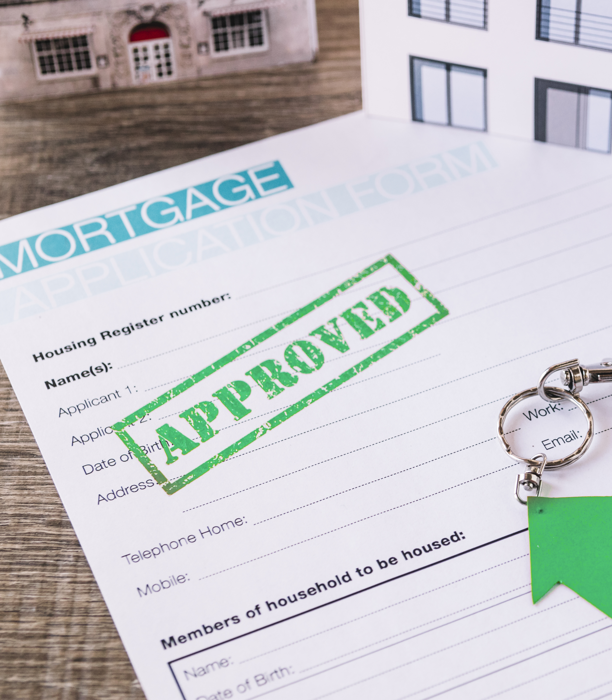
MORTGAGE APPROVAL
Documents required, most of the time, from each applicant:
Purchase and sale agreement
Copy of driver’s license
Job letter from current employer
Past two years’ T4 and notice of assessment (NAO)
Pay stubs for most recent full month
All pages of most recent three months bank statements for savings and checking accounts
Bankruptcy paperwork, if applicable
Divorce and or child support paperwork, if applicable

Slide 9

MAKING THE OFFER
I prepare and review all required documents with you.
We discuss offer price based on latest market statistics.
We discuss Pre-Approval and prepare offer strategy as per situation.
If situation demands, we will use digital signatures.
An offer must be accepted in writing and acceptance delivered to the other party to be a legal contract.
Seller May accept, counter or reject our offer.

Slide 10
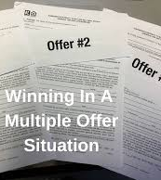
MULTIPLE OFFERS SITUATION
We will know if we are in a multiple offer situation.
You may have to submit offer with more than asking price.
Seller can't tell other buyers our terms and offer Information.
Seller can accept any offer they choose. For example, price higher versus lower, Conditional offer versus firm offer, etc.
If in a multiple offer situation, you may want to come in with your best overall terms and conditions.
Multiple buyers on the same property could be represented by the same agent and/or brokerage.

Slide 11

REASONS YOU SHOULD BUY NOW!!
Interest rates are extremely low
Buy with as low as 5% down payment, if approved
House prices are going up
Affordable mortgage plans available
Utilize RRSP for down payment
Rental homes and apartments are getting more expensive
No tax on any gain on principal residence
Get up to $4000 rebate in land transfer tax

Slide 12
BUYING V/S RENTING
PROS OF BUYING | CONS OF RENTING
Pride of ownership | You have no ownership
Build equity in your own home as value appreciates | No matter what happens you never gain equity
Over the time the mortgage balance decreases, and equity builds as you pay mortgage payment | You make your landlord richer and make yourself poor
You can upgrade your home as you want | Need permission to make any changes
You can use RRSP money for down payment without paying taxes | Can’t use RRSP money to pay your rent
Complete privacy | No privacy
Owing your own home is a forced savings plan | Paying rent is a responsibility
In emergency you can borrow money against your home | Don’t matter how long you are renting you cannot borrow money or landlord won’t give you a penny

Slide 13
GAIN OVER $350,000 IN EQUITY
LET ME SHOW YOU HOW YOU CAN GAIN OVER $350,000 IN EQUITY WITHIN 5 YEARS
Mortgage amount | $800,000
10% Down payment | $80,000
5 Years close mortgage @2.8% with 25 years amortization your mortgage will be reduced to | $118,850
If your home value increase 4% per year, end of 5 years total increase | $160,000
TOTAL GAIN $80,000 + $118,850 + $160,000 = $358,850

Slide 14
MY ROLE
1
LISTEN/ADVISE
As your Advisor, I will listen to your ultimate goals, recommend the right marketing tools to help you reach your goals and share with you my Higher Standards experience and expertise.
2
REPRESENT YOU
As your Negotiator, I will help you explore all your choices, respect your confidentiality and represent your interests to the fullest.
3
HANDLE THE DETAILS
As your Facilitator, I will handle all the details and work to ensure that the deal I put together stays that way.

Slide 15
BUYING YOUR HOME IS A STEP BY STEP PROCESS
1
Initial meeting
2
Understanding your requirements
3
Sending emails to match criteria of homes
4
Book appointment and introduce properties of interest

Slide 16
BUYING YOUR HOME IS A STEP BY STEP PROCESS (CONT’D)
5
Provide a CMA for property of interest
6
Offer Preparation
7
Offer presentation, negotiation & acceptance
8
Deposit for home (24 hrs)

Slide 17
BUYING YOUR HOME IS A STEP BY STEP PROCESS (CONT’D)
9
Financing
10
Home Inspection
11
Waivers
12
Obtain Lawyer
13
Closing
14
Move into new home

